Slide 1
What Java Developers have talked about? An empirical study on Stack Overflow Ahmet S. , Nilgün B. European Journal of Science and Technology (August 2020)
Presented By
Zarin Tasnim Promi
1017052044

Slide 2
Motivation
Java and its libraries have been frequently updated for bugs, change requests, performance and usability requirements
Examining how these changes affect the use of Java and analyze trends in its usage for many reasons:
Learning on demand technology
Finding career track
Usage of better software development tools and practices, etc.

Slide 3
Related Works
Understanding the social evolution of the Java community in Stack Overflow: A 10-year study of developer interactions -Blanco et al.
What topic do developers concern? An analysis of Java related posts on Stack Overflow - Zhang
What are developers talking about – Barua et al.

Slide 4
Contribution of this Paper
Large empirical study on Java discussions to identify:
Main topics
Analyze trends
Trend analysis of both Long term(8 years) and Short term (2 year) period
Proposed methods using the cosine similarity measure for two purposes:
In order to find tags related to Java on Stack Overflow
In order to determine the tendencies of the topics to change over time

Slide 5
Research Questions
What has been discussed?
What has been discussed about each topic in separate periods?
Over the years, which type of topic is prone to change? Which type of topic is steady?

Slide 6
Methodology

Slide 7
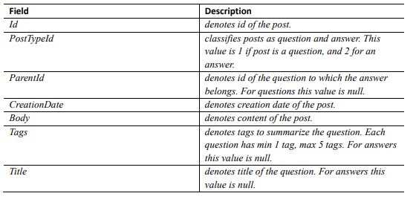
Data Collection
Stack overflow dataset is collected as XML format
First, data is collected using Java Tag
Second, Find related tags

Slide 8
Data Preprocessing
Data Classification by 2-year period
Removal of Code snippet, URLs, HTML Tags, Stop Words, etc.
Application of the Wordnet Lemmatizater Stemming to root word

Slide 9
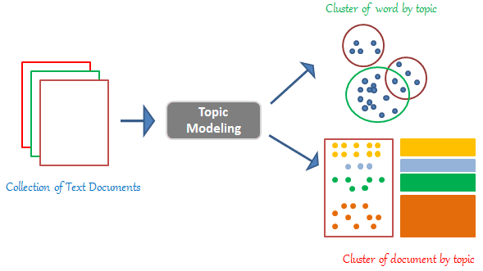
Implementation of LDA
LDA is an unsupervised clustering method for text mining in which:
Each document consists of distributions of the topics
Each topic consists of distributions of the keywords
Tool used: MALLET version 2.0.8
7 similar topic for the 4 time periods are selected for comparison

Slide 10
Result Analysis

Slide 11
RQ1: What has been discussed
Using LDA we get the topics and their related keywords for each 2 year period
For comparison among the 4 time periods, 7 topics and 25 frequent keywords for each topic are selected
Topic names are assigned based on their frequent keywords
Selected 7 Topics are:
JVM operations
GUI programming
Web development
Database operations
Java basics
OOP
Build tools

Slide 12
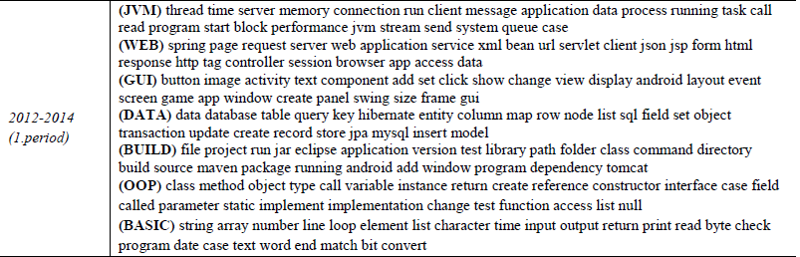
RQ1: What has been discussed

Slide 13
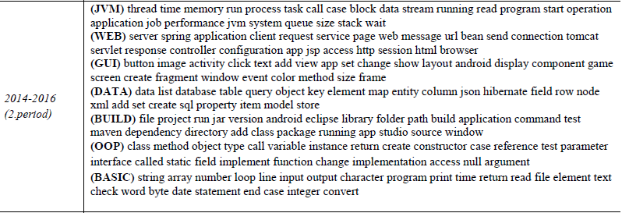
RQ1: What has been discussed

Slide 14
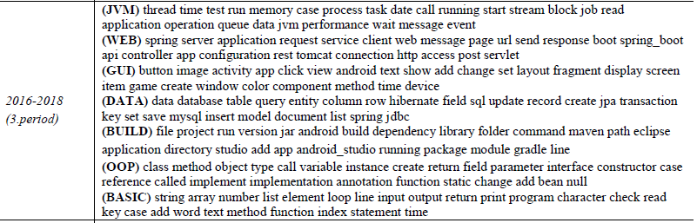
RQ1: What has been discussed

Slide 15
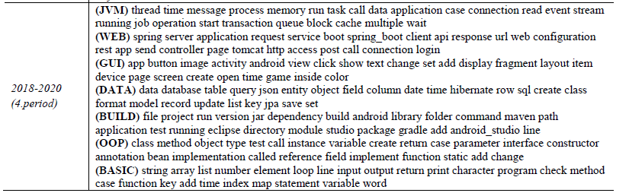
RQ1: What has been discussed

Slide 16
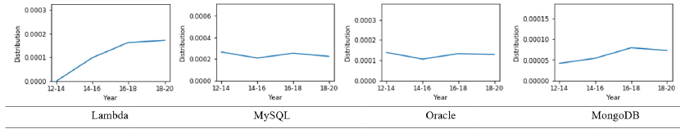
RQ2: What has been discussed about each topic in separate periods
Analyzed Trends of technologies: New, emerging and obsolete
The tendencies are discussed next

Slide 17
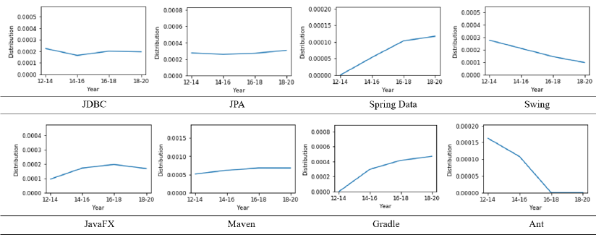
RQ2: What has been discussed about each topic in separate periods

Slide 18
RQ3: Over the years, which type of topic is prone to change? Which type of topic is steady
Divided the 7 topics into two partitions:
Domain specific:
Database operations
Web development
JVM operations
GUI programming
Development environment
Java Basics
OOP
Build Tools

Slide 19
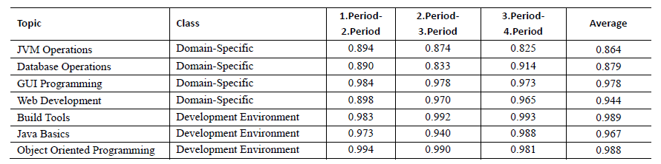
RQ3: Over the years, which type of topic is prone to change? Which type of topic is steady
Short term change analysis:

Slide 20
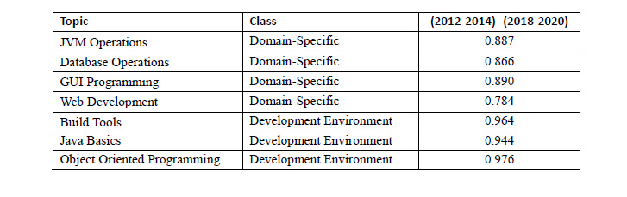
RQ3: Over the years, which type of topic is prone to change? Which type of topic is steady
Long term change analysis:

Slide 21
Future Work
Salvage other developer forum
Other forums: Gitter, Code Ranch, Quora, etc.
Explore Specific Technologies
Spring technologies: Spring Boot, Spring MVC, etc.
Tools: Gradle, Selenium, Docker, etc.
Analyze Other Languages
Explore languages: Kotlin, GO, Python, etc.
Alternative Method of Topic Modelling
Extending abilities of the model
Other models: LSA, NMF, etc.

Slide 22
Thanks everyone !!!

